Slide 1


Embedded Systems Final Project - EBAZ4205
Andrew Pond

Slide 2
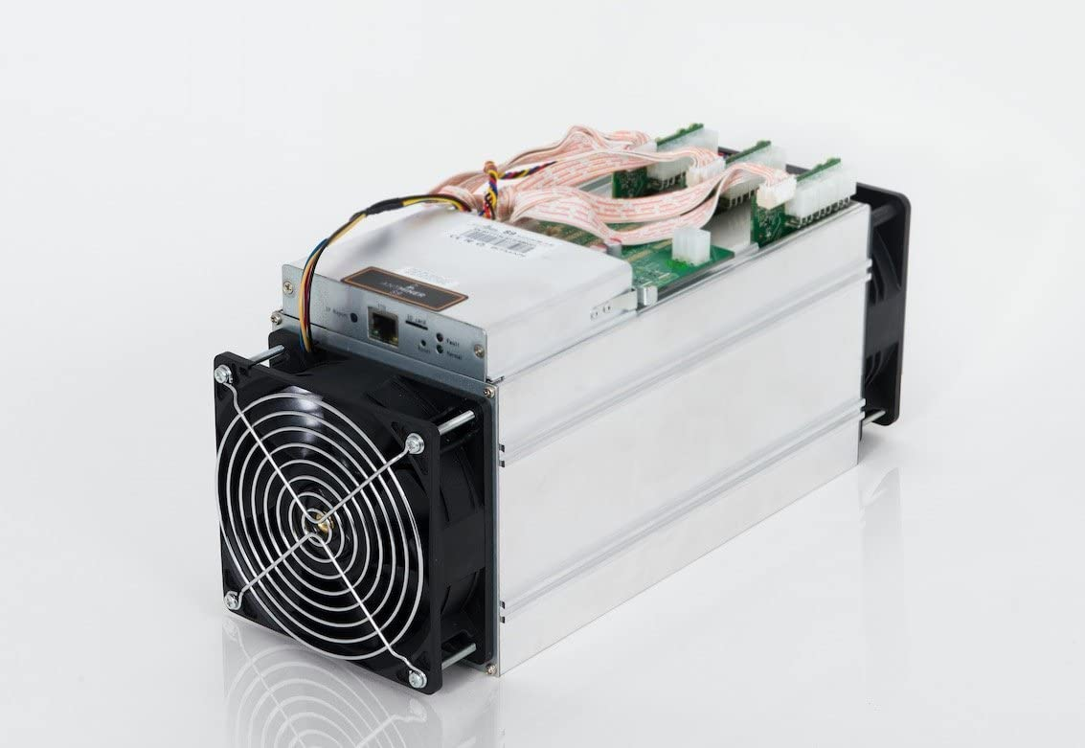
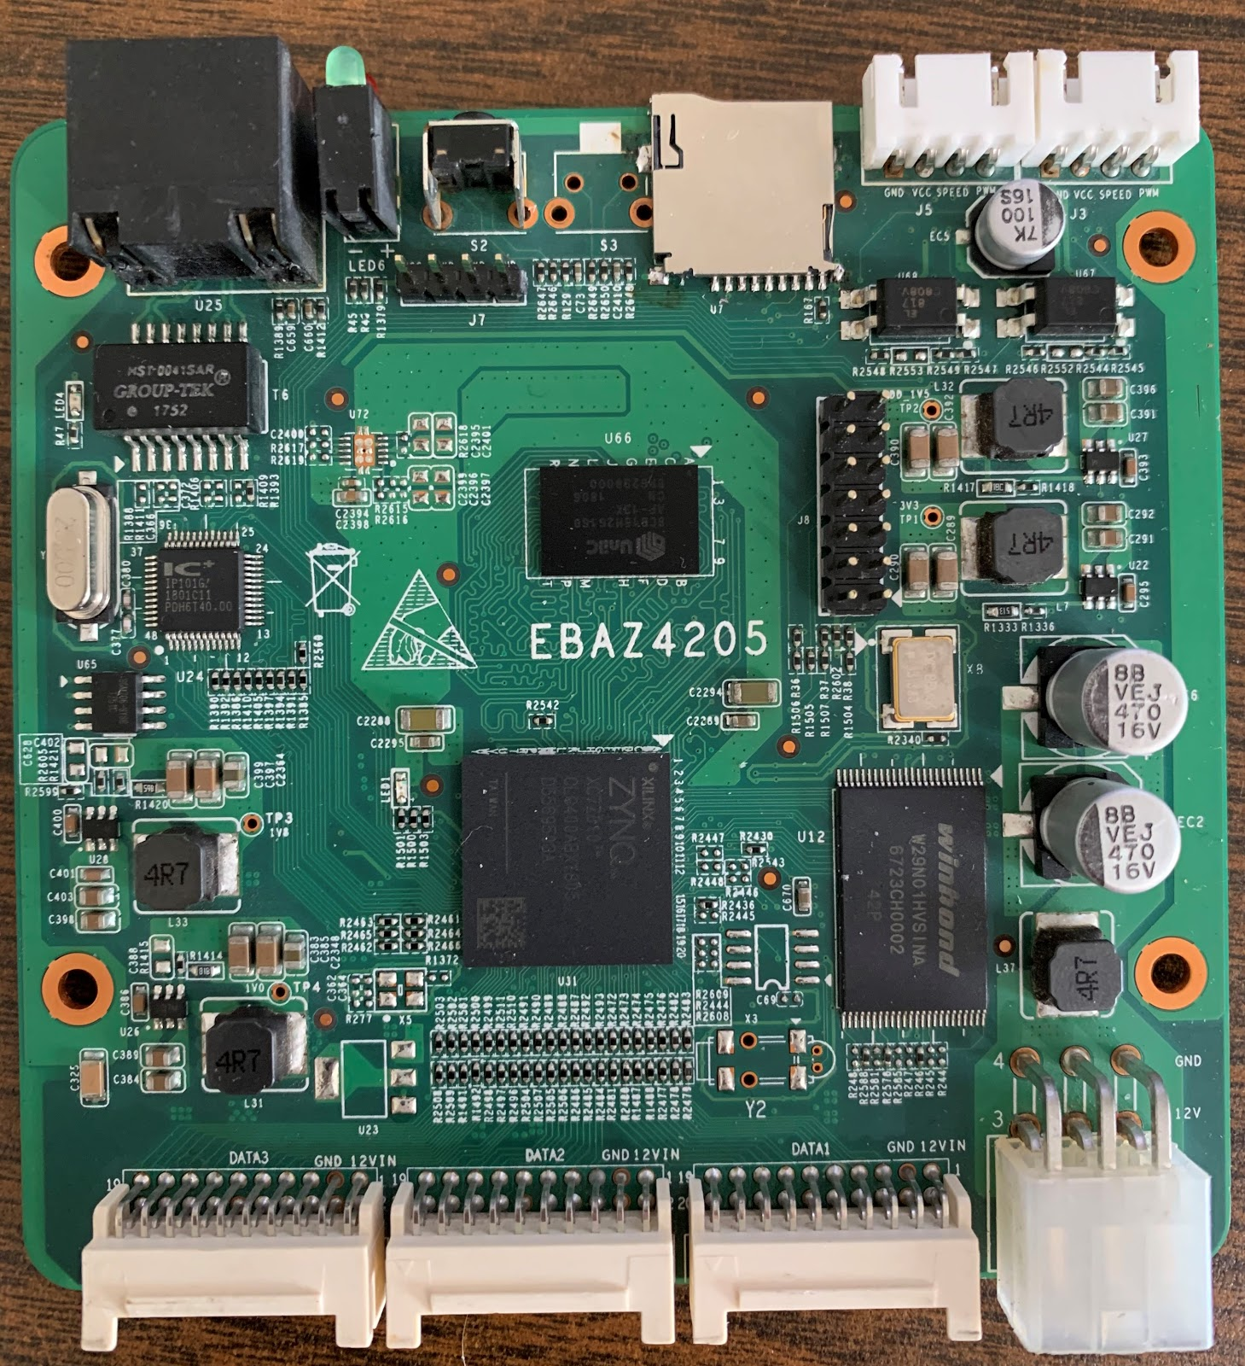
EBAZ4205
What is EBAZ4205?
Old bitcoin miner control board, $15 shipped from China
Most Zynq dev boards cost more than $150
Has Zynq7000 SoC
Dual core ARM
FPGA
Ethernet, SD card, RTC, etc

Slide 3
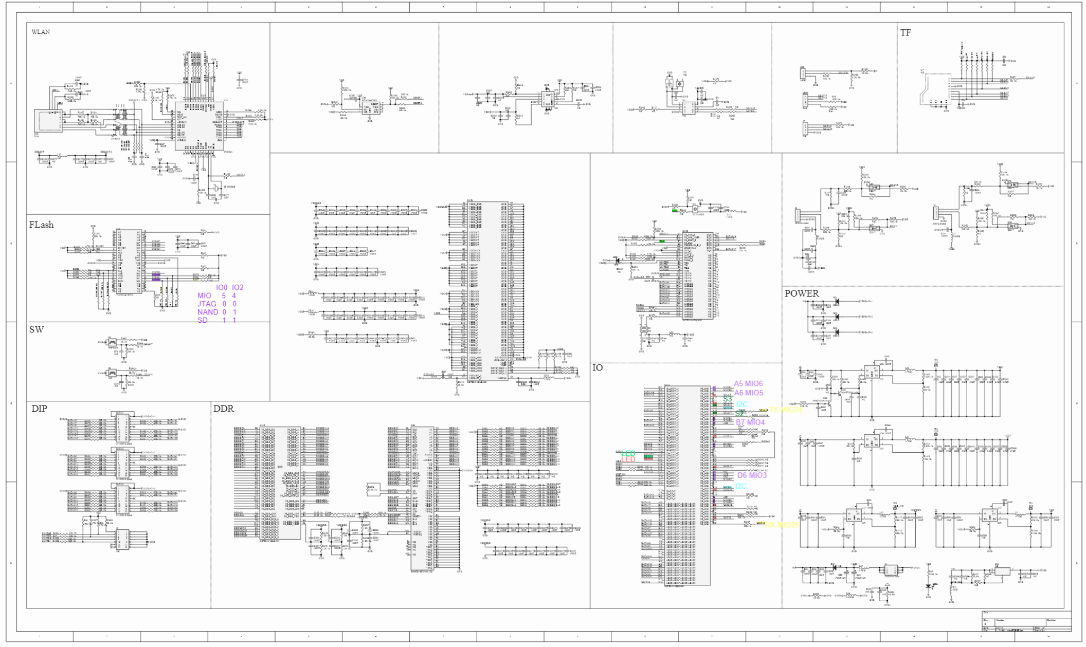
What is the Goal?
Convert board with little documentation/examples into personal dev board
Learn how to configure the processing system
Learn how to use the programmable logic (FPGA)
Get a working demo, prove that I can use both sides of the system

Slide 4
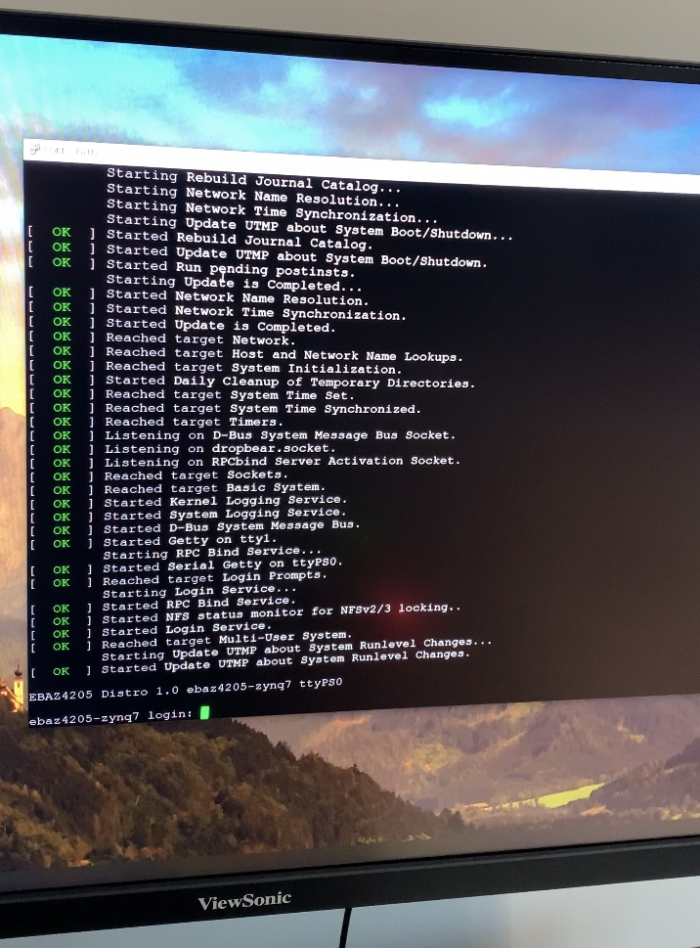
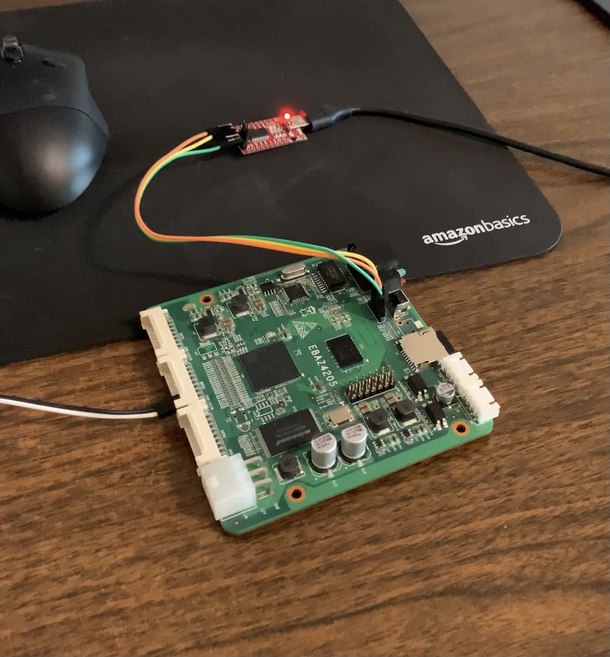
Milestone 1
Functional test of board
Make sure nothing is broken
Boot miner OS and verify it’s working

Slide 5
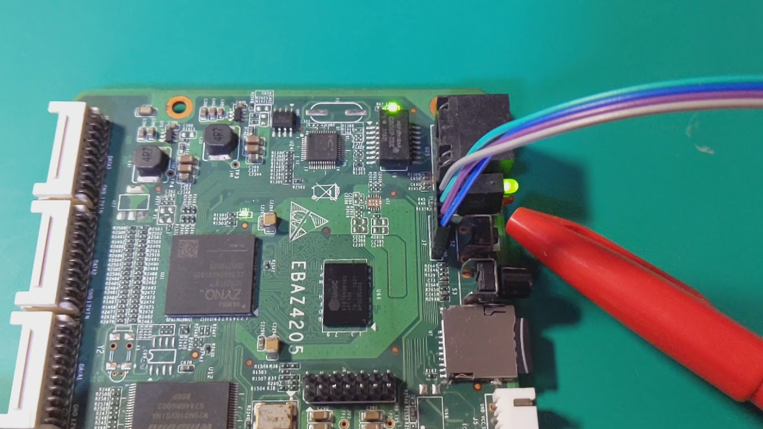
Milestone 2
Linux OS build
Using Yocto utility to build the SD card image
Interact with processor via UART

Slide 6
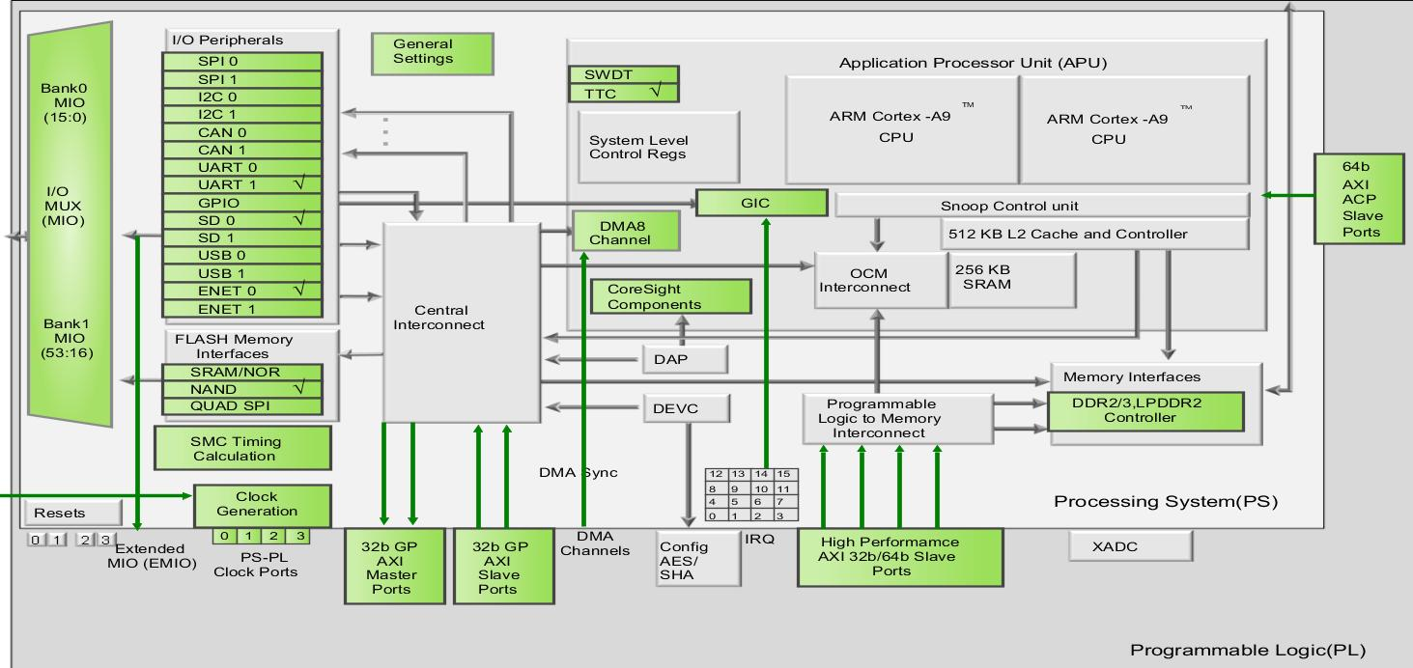
Milestone 3
Programmable logic configuration
Vivado 2020.1
Zynq7000 block design
Simple AND gate

Slide 7
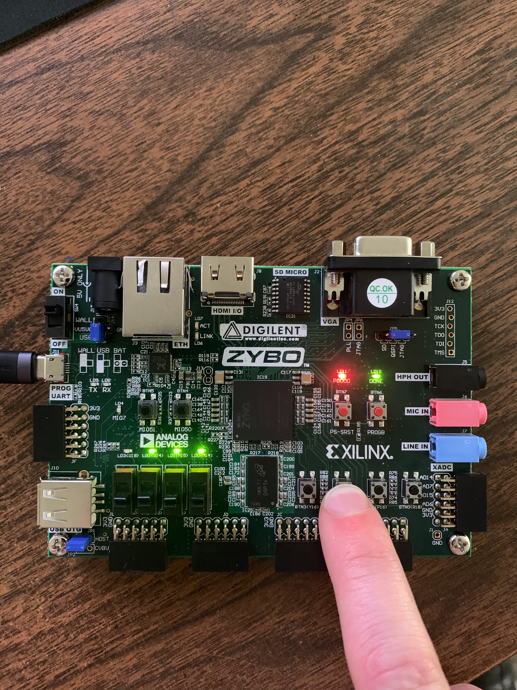
Final Demonstration
Functional logic design
Uses multiple peripherals working together
On ZYBO board, not on EBAZ4205
When button is pressed, corresponding LED lights up

Slide 8
Conclusion
Processing system and programmable logic both working
Learned the flow to build the system
Have a working $15 Zynq development board for future projects
Future Work
Get PS-PL link working (AXI bus)
Write Linux drivers, send/receive data from PL
Get Ethernet working, run a simple server on ARM processor

